Slide 1
Family Peer worker

Slide 2
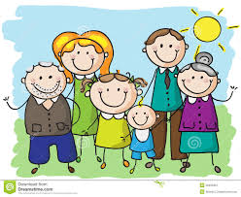
Introduction

Slide 3
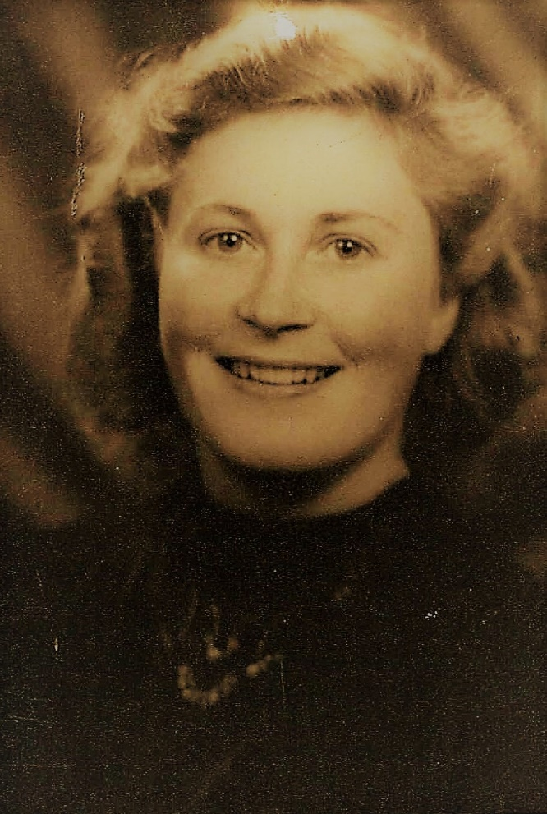

Slide 4
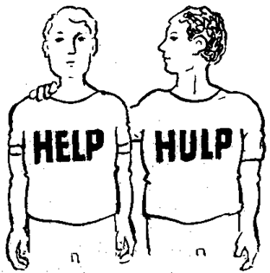
Profile of the Familie Peer Worker
Recognise the experience
Expertise from that perspective

Slide 5
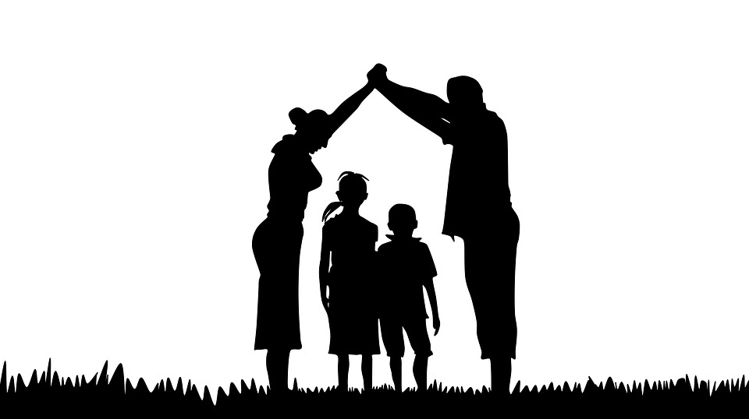
Importancy of the Familie Peer Worker.
Support family
Cooperation between patiënt, family and professionals
Fast recovery and reintegration within sociaty for the patiënt

Slide 6
What does the Familie Peer worker do?
Family:
Listen to the familie
Mediation
Advice
Giving possible solution
Mediate in the triade
Team:
Advising teams over the wishes from families
Share the experience of families
Mediation between cliënt family and team
Working with the management on the development of policies from family perspective
Co-trainer in training and information meetings for family

Slide 7
Daily reality

Slide 8
Tips and advice
Listen to family members and show them you understand their situation
Be honest when you don t have the answers
Don’t promise things you can’t follow up
Be patience and take time
Repaet to the professionals the importence of the family role
Repaet the importance to listen to family
Sometimes you have to be the connection between family and professionals
Take care of yourself. Arrange support
Maintain your independent position

Slide 9
