Slide 1
IPS Outcome monitoring and quality improvement
Cris Bergmans – Phrenos Center of Expertise
The Netherlands

Slide 2
Subjects
Role of the IPS supervisor
Job development
Outcome monitoring and quality improvement

Slide 3
Outcome monitoring and quality improvement Why is this important?
Implementation
Critical part of implementation
Fidelity outcomes
Quality improvement
Tracking what goes well, and what has room for improvement
Policy purposes
Gives insights into benefits of IPS for policy makers and healthcare leaders

Slide 4
Fidelity and outcomes are interrelated!
Is improvement in fidelity associated with improvement in outcomes?
The answer: Yes!
Longitudinal association was found
This means that IPS programs that improve better in fidelity also improve better in quarterly outcomes between assessments
This was also the case for programs who already achieved good or exemplary fidelity scores.
So it is always worth investing in quality improvement.

Slide 5
Implementation
Fidelity assessment: once in 2 years → assessed by Phrenos
Outcome monitoring: Assembled 4 times per year on IPS program level → assembled by Phrenos in dataportal
Quality reports: Twice a year: reports with feedback on how IPS programs are performing
Plan for improvement points of feedback

Slide 6
What outcomes do we assemble?
Should contain at least the following program level outcome metrics:
Caseload size: Number of service users, how IPS is funded per person, type of IPS program (SMI, CMD)
Employment outcomes: Number of people working /starting/quiting job, sustainable
employment, how fast people obtain their first job.
Education outcomes: Number of people in education / starting / quiting education
Drop-out: Number of people dropping out of IPS incl. reasons for drop-out
Capacity: Number of IPS specialists and time available for them (FTE’s)

Slide 7
Procedure outcome monitoring and quality reporting
Registration | Outcome reporting | Outcome processing | Feedback | Action
Legenda: Mental health Phrenos Dataportal (Akwa GGZ) Labour market regions National policy makers (Hoofdzaak Werk / Divosa)
Registration aggregated information
Deliverable in dataportal
Check data quality and processing information from data portal to quality reports.
Development of quality reports organization and region
Quality reports MHC and labour market regions
Co-development and guidance feedback
Dissemination, recommendations for practice and policy, national report, research
Support in registration with documents and advice
Facilitate infrastructure dataportal
Supporting data quality check and processing information
Facilitate with the content
Feedback on user experiences quality reports
Improving practice based on quality report
Steering proces of registration, reporting and feedback on quality reports
Improve practice, setting an agenda and make regional policy
Steering proces of registration, reporting and feedback on quality reports
National coordination and making policy, setting funding.

Slide 9
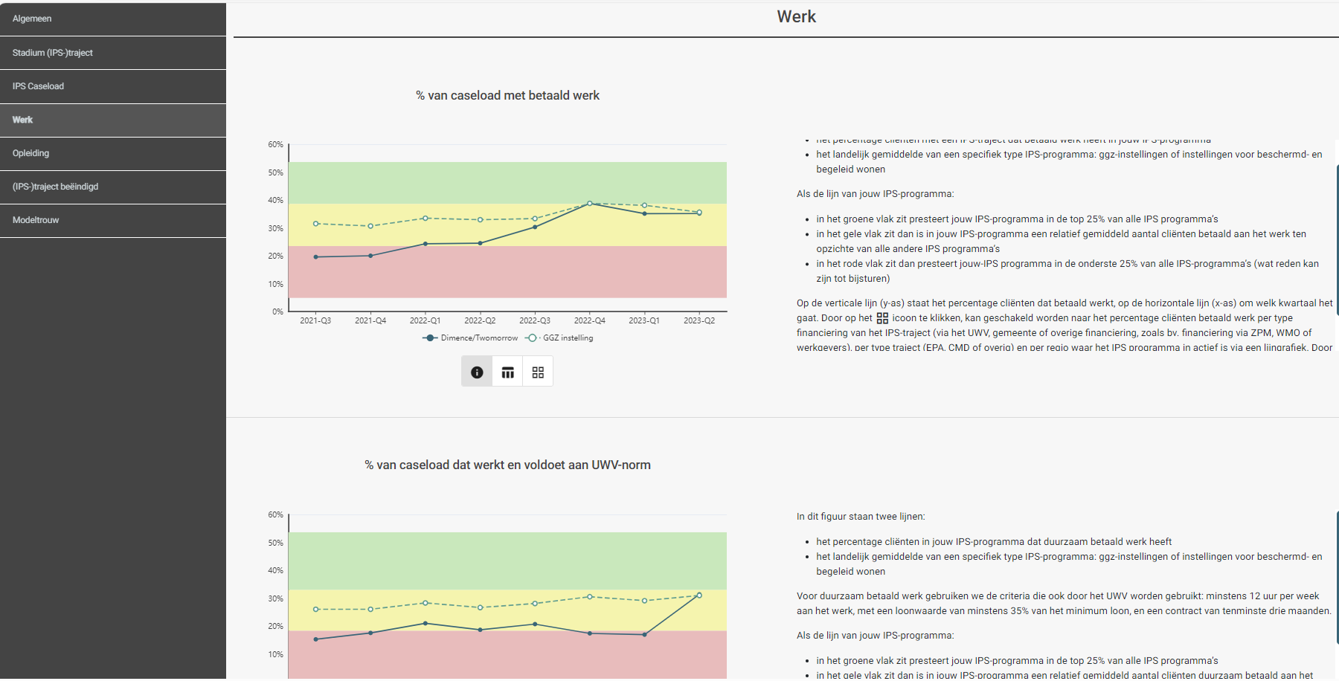

Slide 10
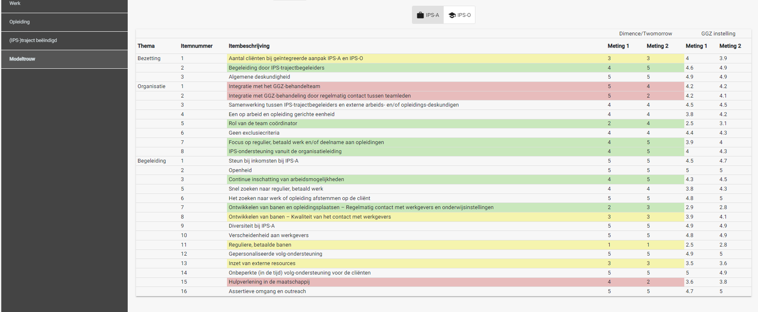

Slide 11
So why are we doing this again?
Quality improvement: Learning by data and improving fidelity leads to better results!
Regional and national insights: Monitoring leads to better insight how it goes in the country and in specific regions.
Collaboration: By sharing results we can use this as an instrument to talk between stakeholders.
Making policy: Sharing outcomes gives insights which policy makers can use to improve policy and setting the funding on a regional and national level.

Slide 12
Let’s get started!
Questions?
Lars de Winter: Lwinter@kcphrenos.nl

Slide 13
The role of the IPS Supervisor
The IPS-supervisor plays an important role but is sometimes underestimated (Dorsey e.a. 2017)
It can be difficult to combine the role of IPS-supervisor with another supervision role like team leader day care activities

Slide 14
The role of the IPS Supervisor
Five key roles of the employment supervisor:
Role 1
• One full-time equivalent (FTE) supervisor is responsible for no more than 10 employment specialists. The supervisor does not have other supervisory responsibilities. (Program leaders supervising fewer than ten employment specialists may spend a percentage of time on other supervisory activities on a prorated basis. For example, an employment supervisor responsible for 4 employment specialists may be devoted to SE supervision half time.)
Tips
Not combining IPS-supervisor with other supervisory responsibilities
Team is not too big

Slide 15
The role of the IPS Supervisor
• Role 2
Supervisor conducts weekly supported employment supervision designed to review client situations and identify new strategies and ideas to help clients in their work lives.
Tips: Fixed agenda for team meeting
- Funding IPS trajectories? Already in contact with VR services about IPS?
- Job development? Searchers for jobs? Acquisition (done and planned)
- Celebrations!!! Celebrate your successes (no matter how small)!
- Communication about IPS (website, brochures, meetings)
- Internal and external developments
- Case study. Employment specialist descripes a case with a question or problem (intervision) and asks for advice

Slide 16
The role of the IPS Supervisor
• Role 3
• Supervisor communicates with mental health treatment team leaders to ensure that services are integrated, to problem solve programmatic issues (such as referral process, or transfer of follow-along to mental health workers) and to be a champion for the value of work. Attends a meeting for each mental health treatment team on a quarterly basis.
Be an advocate inside your organization for IPS and regular paid work
Solve all kind of issues (intake in mental health (attendance to paid work), communication, documents in Client dossier etc.,)

Slide 17
The role of the IPS Supervisor
Role 4
• Supervisor accompanies employment specialists, who are new or having difficulty with job development, in the field monthly to improve skills by observing, modeling, and giving feedback on skills, e.g., meeting employers for job development.
Monitor and help new employment specialists!!
Give individual feedback and set goals! Monitor outcomes!

Slide 18
The role of the IPS Supervisor
Role 5
Supervisor reviews current client outcomes with employment specialists and sets goals to improve program performance at least quarterly.
Discuss as supervisor client outcomes with employment specialists
Track outcomes of the IPS-programs and set goals

Slide 19
Job Development
Notes:
It strikes fear and anxiety into the hearts of all who need to it! Except for those lucky few who thrive on it…

Slide 20
Job Development in IPS…
Frequent contact with employers is important for building up a relation (6 contacts a week)
Track employers contact and discuss new contacts and job openings in teammeetings
If the employment specialist have difficulties in building up a network discuss this on individual level
Develop strategies for job development (cold and warm approach)
For building employer relations a simple approach; three cups of thee

Slide 21
Job Development in IPS… why the fear and stress?
Variety of reasons:
People are uncomfortable going out and ‘selling’- we are human services people, not ‘sales’
People don’t know how to ‘job develop’ and we don’t always offer a comprehensive training to our staff required to do this task
There really isn’t a set, perfect way to job develop
Rejection.

Slide 22
Three Cups of Tea
Strategies frequently used for job development:
Cold calls
Knocking on Doors
Become a customer at the business
Attending Chamber meetings
Join Business networks
Notes:
These ways aren’t wrong, and they can work, but the Three Cups of Tea model offers another tool in your job development tool box. It seems to open doors and build long lasting relationships with employers for ongoing placements.

Slide 23
The “First” Cup of Tea
Purpose: To set up a time to meet with the employer to learn about the business.
- The first step in building the relationship.
- It should take only 5-10 minutes.

Slide 24
The “First” Cup of Tea
The Approach:
DON’T start by asking for a job!
Slow down and introduce yourself.
Concentrate on getting a 15-20 minute meeting on their calendar at a time that is convenient for them.
This contact should be all about the employer, not your agency. BUT, if they want to talk to you then, you should be prepared with questions.

Slide 25
The “First” Cup of Tea
How to Prepare:
Look up basic background information on the company.
Know and avoid the ‘busy times’
Figure out who the right person is to talk with- it is the person who hires. You might want to call to see if they will be in.
Look to see if there is a prior contact with the company and what transpired.

Slide 26
The “First” Cup of Tea
How to Prepare:
Make sure you have business cards
Make sure you have your smartphone to access your calendar, or appointment book
Prepare and practice your ‘spiel’ or Introductory Job Development Statement

Slide 27
The “First” Cup of Tea- Introductory Job Development Statement
⇨ Your Name
⇨ Your Employer
⇨ What you do
⇨ The purpose of the visit

Slide 28
The “First” Cup of Tea – Introductory Job Development Statement
Example 1:
“Hello. My name is Cris Bergmans and I work for Job Opportunities here in town. I am an Employment Specialist and my job is to introduce employers to people who have the skills those employers need. One of my responsibilities is to learn about local business. Would it be possible to schedule a 15-minute appointment with you to learn more about what you do here and the type of person who is a successful employee at your business?”

Slide 29
The “First” Cup of Tea – Introductory Job Development Statement
Simple
You aren’t asking for anything other than a convenient time to come back and learn about the employer
You don’t have to mention the name of your agency (although be prepared that some employers may ask!), especially if it may stop the conversation from progressing
You want it to feel natural- practice saying it out loud!

Slide 30
The “First” Cup of Tea
Follow Up:
Confirm your appointment.

Slide 31
The “Second” Cup of Tea
Purpose: To learn as much as you can about the company and continue building the relationship with the employer.
-Should take 15-30 minutes

Slide 32
The “Second” Cup of Tea
The Approach: This is your time to learn everything you want to know about this particular employer and their hiring practices.
-It is still only about the employer.

Slide 33
The “Second” Cup of Tea
How to Prepare:
Research the business on line (product, shifts, history in community)
Look for the mission statement, values, and information regarding company culture on their website

Slide 34
The “Second” Cup of Tea
How to Prepare:
Prepare questions to ask of the employer:
What do you look for in an employee?
Are there certain jobs with high turnover rates? What sort of challenges do you have hiring/keep good employees?
What are your needs at present?
What types of jobs might you have that I might not know about?

Slide 35
The “Second” Cup of Tea
How to Prepare:
Prepare questions to ask of the employer:
How do people typically move up in the field?
What part-time/full-time jobs do you have? Seasonal/temp positions?
Do you hire employees for 2-3 hour shifts, or possibly 2-3 hours per week?
Are you planning to expand?

Slide 36
The “Second” Cup of Tea
How to Prepare:
Prepare questions to ask of the employer:
How would you describe your best employee?
What is your hiring process like? (online screenings, etc.)

Slide 37
The “Second” Cup of Tea
What to bring:
Smart phone with calendar or appointment book
Just in case the conversation flows naturally to the Third Cup, also be prepared with:
Employer References
Information packet on your agency
Success stories/articles
A few resumes that may be a good match

Slide 38
The “Second” Cup of Tea
Follow Up:
Send a thank you note to the employer.
Document and track the contact for others at your agency.

Slide 39
The “Third” Cup of Tea
How to Prepare:
Review your notes from the previous two meetings.
Be prepared to describe at least three strengths of the individual you plan to recommend as a candidate.
Make sure that the individual has an up to date resume.

Slide 40
The “Third” Cup of Tea
Approach:
Say “ I’ve been thinking about what you told me about your company and the jobs that are typically difficult to fill and I have a person in mind that I’d like you to meet- I think he would be a great match for your hiring needs. He’s good with details (describe the person’s strengths). Would you like me to set up a time for you to meet with him?

Slide 41
The “Third” Cup of Tea
Follow Up:
Send a thank you note.
Drop in again or set up the person’s interview.

Slide 42
“Three Cups of Tea”
First cup may flow into the third, but that shouldn’t be the goal.
Should keep going back for the fourth, fifth, sixth cups of teas….
It isn’t always going to work or always be the right approach to use, but it lessens the stress on staff going out to build these relationships and offers a clear process to follow.

Slide 43
Conclusions
Use different strategies to find jobs (Cold & Warm strategies)
Warm: network of the clients and colleagues, employer meetings, your own network, Social Return on Investment
Cold: three cups of thee and building up a relation

Slide 44
Questions?
?

