Slide 1
IPS in the Netherlands: An update
Cris Bergmans
IPS-trainer Phrenos Center of Expertise

Slide 2
Our history with IPS
2002: IPS introduced in the Netherlands through Jaap van Weeghel
2003 – 2006: Implementation study → 4 Dutch MHC organizations implemented IPS (Van Erp et al., 2007)
2007 – 2014: Involved in 2 RCT’s:
EQOLISE (Burns et al., 2007) → no indications of effect in the Netherlands
Dutch RCT (Michon et al., 2014) → Significant effectiveness indicated
2017 - now: Structural funding for IPS for people with SMI and a disability benefit by National Employee Insurance Agency
2019 – now: Implementation study IPS for CMD (De Winter et al., in progress)
2021 – 2023 National collaboration with municipalities and labour market regions → funding for
IPS by municipalities (for people on social benefit) in 2023 and 2024. Advocating for structural funding after 2024

Slide 3
Implementation of IPS
IPS implemented in:
Specialized mental health care teams (Flexible Assertive Community Treatment)
Supported housing facilities
Target group: Mostly severe mental illnesses (approx. 80%), but also common mental disorders (approx. 20%)
IPS funded by: employee insurance agencies (majority), municipalities, other funding sources (variable such as Health Care Insurance)
Phrenos facilitates with: training, fidelity reviews (every 2 years), outcome monitoring and learning network
Cycle of quality improvement

Slide 4
Quality improvement: example of the Netherlands
IPS quarterly outcome reports by IPS programs
Quality reports, incl feedback points
Control and process of data in data portal
Fidelity scores IPS programs
4 times per year quality reports to IPS program
Plan for improvement of feedback points by IPS program
Once in 2 years
Reader manual with instructions and tips how to interpret data
IPS programs
Phrenos
Data portal

Slide 5
The growth of IPS in the Netherlands

Slide 6
Quarterly outcomes per year

Slide 7
Fidelity assessments

Slide 8
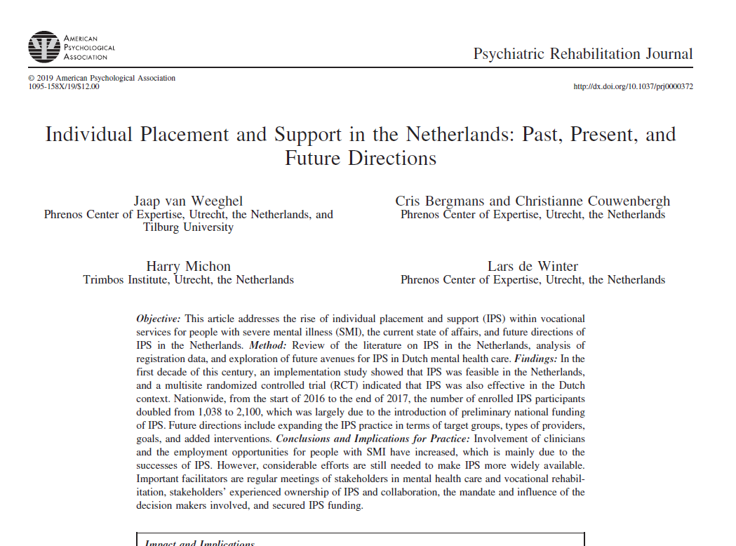
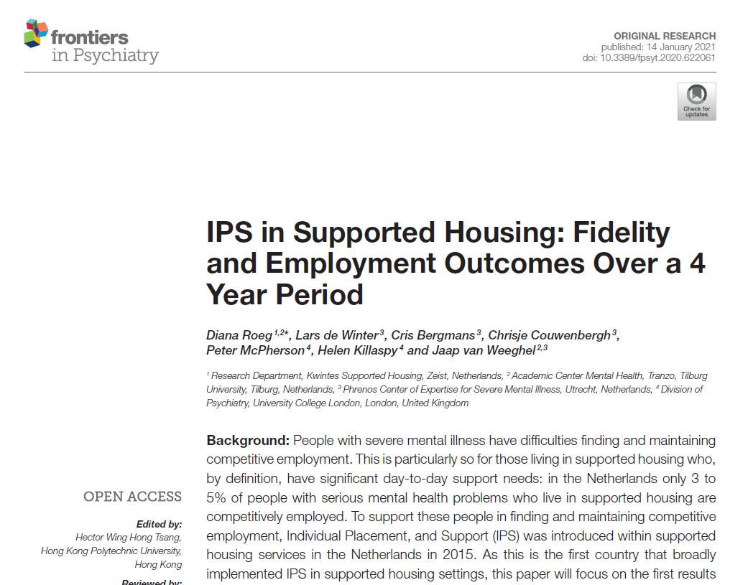
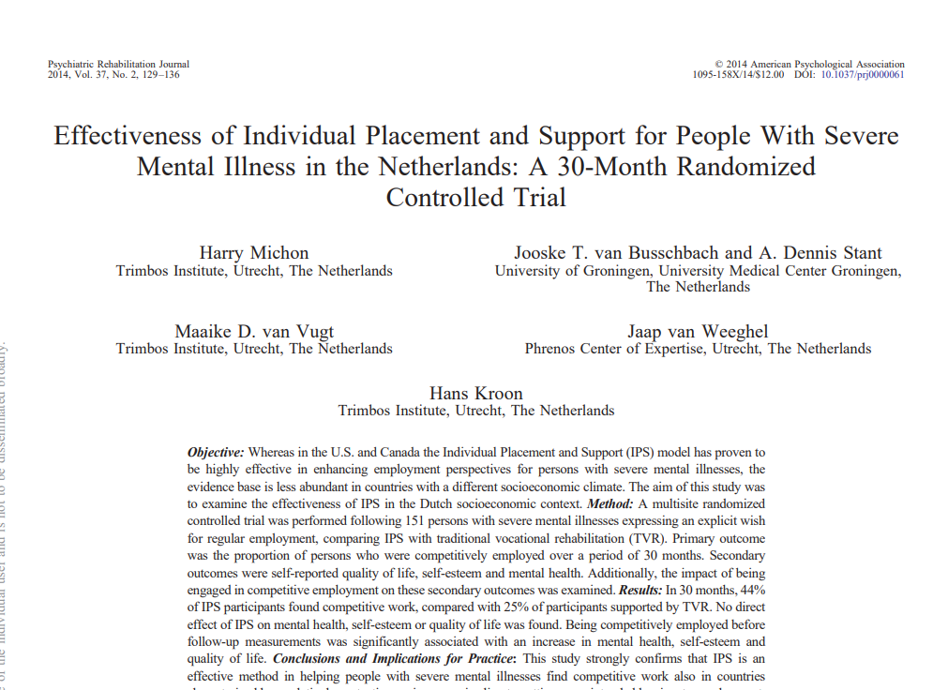
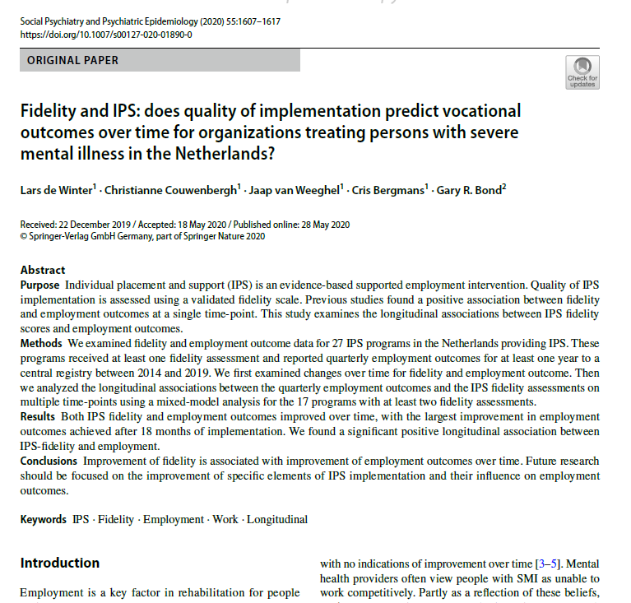
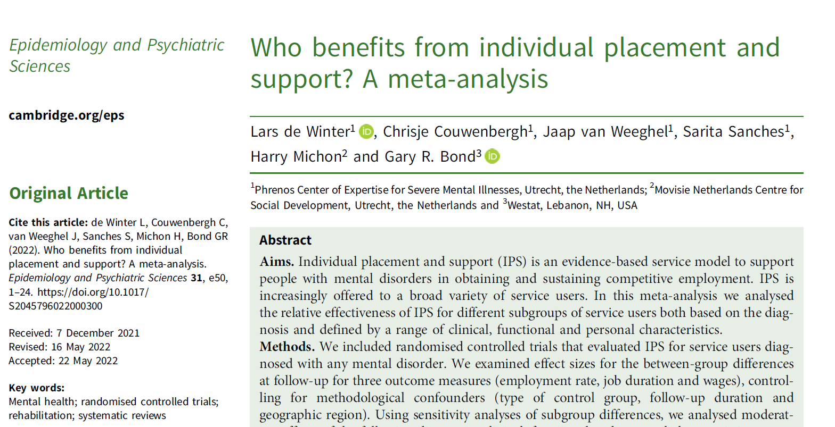
IPS research overview

Slide 9
Future directions
Broadening the scope and horizon of IPS:
Target group: CMD, mild intellectual disabilities, acquired brain injury, etc…
Other setting: outside mental health care
Stronger collaborations between government, IPS programs, employee insurance agency and municipalities
→Hoofdzaak Werk: coordinated per labour market region: not only IPS, but all vocational rehabilitation.
Keeping track of collaborations between stakeholders → work monitor
Improving availability, optimizing results of vocational rehabilitation and improve sustainability of employment through ‘Bridging the Gap’ project → 6-year cohort study

Slide 10
IPS en Center of Expertise Phrenos
Expertise Center Phrenos member of International Learning Collaborative (IPS Center, Rockville Westat)
Offering an Implementationtraject voor Mental Health services who want to start with IPS.
5 IPS trainers involved who are training people for IPS employment specialist:
Central IPS platformmeetings for managers, policymakers and employmentspecialists;
IPS fidelity reviews by 7 trained reviewers;
Collecting IPS outcomedata
Website www.werkenmetips.nl

Slide 11
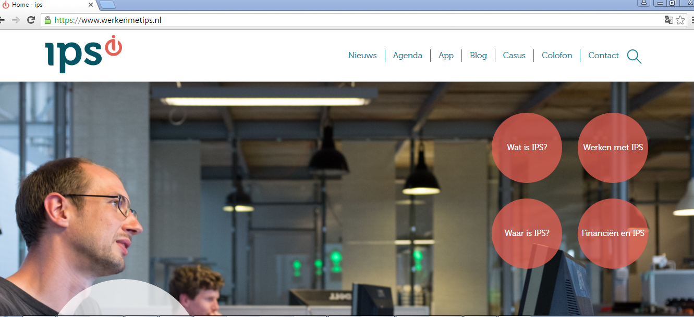

Slide 12
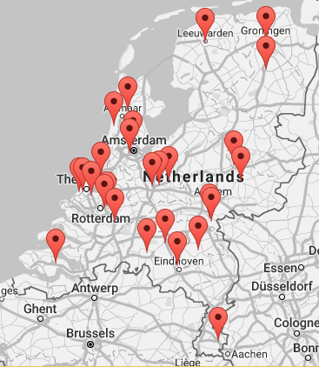
Results
IPS implemented in 32 mental Health organisations.
More then 500 people trained as IPS empoyment specialist
SCION, Dutch effectstudy on IPS showed that IPS is more effective than traditional approach (Van Busschbach, e.a., 2014
etips.nl

Slide 13
IPS in Europe
Cris Bergmans
IPS-trainer Phrenos Center of Expertise

Slide 14
IPS in Europe
IPS Started in Europe with some early adapters: England, Italy, Netherlands, and Switzerland
The EQOLISE study, a multi-country RCT was commissioned in 2007 to test IPS in 6 European countries: Bulgaria, Germany, Italy, Netherlands, Switzerland, and the UK
The study delivered excellent results, despite extensive differences from USA in labour market regulations, varying (generally) higher unemployment rates and welfare benefits and in the organization and culture of mental health services.
IPS proved to be superior to treatment as usual for the number of people entering the competitive market (55%v.26%), the number of days and hours worked, and the amount of money earned.

Slide 15
IPS in Europe
The 2007 EQOLISE findings spurred the expansion of IPS across Europe at different paces in each European country. Furthermore, following on the EQOLISE study, a growing number of countries started to further evaluate IPS with formal RCTs and local pilots and implement.
Factors that stimulated the growth of IPS have been identified as:
The impact of local IPS research studies
Local champions and dedicated national leaders
Participating in the international IPS Learning Community
Fidelity monitoring

Slide 16
More European countries implementing IPS
IPS programmes are currently found in Belgium, Czech Republic, Denmark, Finland, France, Germany, Iceland, Ireland, Italy, Netherlands, Norway, Spain, Sweden, Switzerland and UK.
Nine RCTs on IPS have been conducted, in six European countries all with results in favour of IPS.
The degree of implementation of IPS varies, as do implementation barriers that each programme has to face. In each European country, the organization of governmental services, funding of mental health and vocational services, labour legislations, disability policies, national history and culture have all shaped the evolution of IPS services on a system level.

Slide 17
Implementing strategies (bottom-up/top down)
The first one goes bottom-up, with pilot centres developing it and then sensitising other professionals, managers and decisionmakers.
The second way goes top-down, with leaders, stakeholders and policy-makers adopting it regionally or nationally and lobbying by international bodies.

Slide 18
Developments in IPS (new target groups and variety of providers)
IPS gets more and more extended to all individuals with mental illnesses (not only SMI)
Nowadays, for instance in the Netherlands, IPS practices are not only present in community mental health teams, but have also been developed successfully in psychiatric community housing programmes (De Winter et al., 2020).
In Norway, Sweden and the netherlands, IPS has been made accessible to clients with common mental disorders and substance use disorders (Bejerholm et al., 2017; Reme et al., 2018; Hellström et al., 2021).

Slide 19
Developments in IPS (variety of providers)
Second, there is an increasing variety of IPS providers.
Originally, mental healthcare organizations have been the main actors adopting IPS practices.
In some European countries, IPS is mainly provided by (contracting organizations of) municipal social service departments (e.g. in Denmark, Norway and Sweden).
To attain optimal adoption and sustainability, now systems tend to form broad coalitions and shared ownership of IPS, including at both local and national levels, mental healthcare providers, general social service services and employment services, the vocational rehabilitation system, service users and family organizations and (in some countries) health insurance companies
This development also raises the problem of how to ensure increased access to IPS without compromising fidelity (Bond et al., 2020).

Slide 20
Development in the use of additional interventions to reinforce the effects of IPS
Examples of add-on interventions are:
cognitive remediation (McGurk et al., 2015; Christensen et al., 2019; Van Duin et al., 2021),
Wellness Recovery Action Planning (WRAP) (Van Erp et al., 2015) and
COnceal or ReveAL (CORAL), a decision aid for disclosure of mental health problems in the workplace (Henderson et al., 2013; Janssens et al., 2020).
sharing personal experiences, peer support workers in IPS programmes, and the use of virtual reality interventions

Slide 21
European Learning Collaborative
Initiative started in 2019 a few enthusiasts from various countries (Iceland, Italy, Netherlands, Spain, UK)
After some preparatory online discussion meetings, other IPS practitioners from European countries were identified and contacted by using professional networks
Establishing through the ELC stable collaborations and exchanges by centres that actively practice IPS will enhance further development in Europe, improve sustainability and implementation in a European context, and allow testing its effectiveness in other target groups.
2021: Meeting in Reykjavik
2022: Meeting in Berlin
2023: Meeting in Rimini (with 19 European Countries)
2024: meeting in Ireland

Slide 22
IPS in Europe
https://ipsgrow.org.uk/providers/ips-europe-learning-community/

