Slide 1


Peer Support Work- potentials and pitfalls
Bengt Karlsson & Marit Borg
Center for Mental Health and Substance Abuse
Faculty of Health and Social Sciences
Department of Health, Social and Welfare Studies
Marit.Borg@usn.no Trude.Goril.Klevan@usn.no

Slide 2
Peer Support Work in Norway
Background, roots & definitions
Research on peer support work
Unique roles & contributions
Training & supervision
Challenges

Slide 3
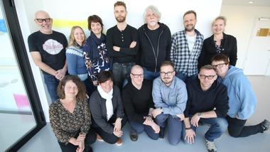
Centre for Mental Health and Substance Abuse
Established 2010, led by professor Bengt Karlsson Bengt.karlsson@usn.no
Multidisciplinary research group – nursing, social work, occupational therapy, pedagogy, child welfare, sosiology, social education
Research competence, clinical experience, lived experience

Slide 4


Centre for Mental Health and Substance abuse
Research areas
Recovery and recovery-oriented practices
Dialogical and collaborative practices
Child and adolescent issues
Collaborative research in and with practice

Slide 5
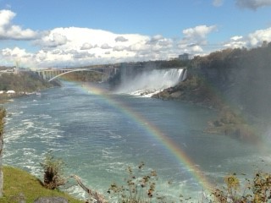
What is Peer support work (PSW)?
Help and support that people with lived experience of life challenges like mental health &substance abuse problems or being refugees or…. are able to give to one another.
It may be social, emotional or practical support

Slide 6
What is Peer support work (PSW)?
Direct work: advocacy, connecting to resources, experiential sharing, building community, relationship building, group facilitation, mentoring, hope
Indirect work: service development. (i.e. new services), group planning and development, administration, supervision/training, education/awareness building, anti stigma work, information sharing
Peers also do work aimed at building relationships with staff & legitimizing the peer role ( Valuing lived experience, role modeling, advocacy)
BMC Health Serv Res. 2012 Jul 19;12:205. doi: 10.1186/1472-6963-12-205. What do peer support workers do? A job description.
Jacobson N¹, Trojanowski L, Dewa CS.

Slide 7

Why Peer Support Work & Research?
Central part of recovery – need to build evidence
Need to know more about PSWs unique contributions
Need to know more about PSWs working conditions
Limited insight of lived experiences as knowledge area and knowledge base

Slide 8
What do we know about PSW?
Variety of concepts and practices
Peer support, selfhelp groups, mentorship…..
Positive findings in research:
Strengths- focussed social and practical support, love-labour, non-judgemental (understood and accepted)
Trusting relationships- reciprocal
Increased community participation ( accessability to work & activity & networks)
Experiencing hope for the future (hope for a life beyond the problems)
Awareness of experience based knowledge and competence
Senter for Psykisk helse og Rus

Slide 9
Some challenges
  Not automatically a helpful relationship
  Difficulties in clarifying roles and relationship boundaries
  PSW may think their recovery pathways fit all
“The findings suggest that peer-support by sharing lived experiences does not always result in helpful relationships that promote recovery. How and when aspects of lived experience are shared appears to play an important role in characterizing relationships” (Ogundipe et al, 2019).
Senter for Psykisk helse og Rus

Slide 10
Recovery Orientation and Peer Support Work in Norway
Great interest: particularly in community services, education, service-user organizations, national competence centres, research
Fits well with international and national policies
Many-facetted: promising examples of helpful help; b) tokenism and symbolic practices; c) PSW is not always helpful; d) PSW insecure jobs ( temporary jobs, low wages, lived experience not valued )

Slide 11
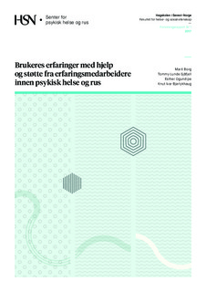
Service-users experiences with help and support from peer support workers in mental health and substance abuse services
Borg, Marit; Sjåfjell, Tommy Lunde; Ogundipe, Esther; Bjørlykhaug, Knut Ivar https://brage.bibsys.no/xmlui/handle/11250/191431

Slide 12

Persons experiences of help and support from PSW
In which ways did they experience help and support
Did the PSW support their recovery?
In which ways were the PSWs not helpful?
Are there differences in being helped and supported by PSWs & professionals? How?

Slide 13
User-involved collaborative researchproject
-governmental and non-profit-making organizations
  Steering group and competence group
  5 Focus group interviews
  26 persons; 17 w & 9 m.
  Age: 40-66
  Supported in services, user-run places and 3rd sector ( non-governmental / non profit)
  Great interest and pride
  Thematic analysis

Slide 14




Findings
I listen more carefully at once
PSW builds bridges to services and community
It depends on the person
A place you can be yourself

Slide 15
I listen more carefully at once
To be seen and listened to in a different way
  «Right feedback… All that fussing and puttering. It didn’t work for me…I need clear messages and expectations …not this unclearness»
Respect and equality
This immediate understanding and trust
Kind of sensitivity and «right feedback»
The importance of expectations and make demands

Slide 16
…hope and inspiration
«…very inspiring to see others having been where you are and actually have gone on with their lives…..and use their experiences to something productive and useful…»
« It’s not easy for people who’ve been drug addicts to get a job….or to be seen as someone who can contribute….so he has really given me hope…»
Being together with the right people can
give hope
The importance of being inspired and inspiring others
Gives couarage to meet challenges

Slide 17
PSW builds bridges to services and community
« My peer support worker helps me in a way to find the right words»
Services:
Language and translators in services
Support and understanding
Advisory boards, staff training
Service development
Community:
Pushing into participation
Meaningful everyday life
Friends

Slide 18
It depends on the person
  « Some professionals are so good that they must have some lived experiences….»
It depends on the person and our realtion
«He didn’t listen to me»
«Depends on how far the person has come
in his own process»

Slide 19
A place where you can be yourself
Openminded people and places
Helps when feeling lonely and as an outsider
Makes people feel useful for one another

Slide 20

It’s kind of like a separate language”
“Peer support workers understandings and use of experience based knowledge in their collaboration with users in mental health- and substance abuse services.
Klevan, Trude; Sjåfjell, Tommy Lunde; Borg, Marit and Karlsson, Bengt.

Slide 21
Background
Peer support workers use their own lived expeirencesas their most important source of knowledge
Experiences are recognised as an important and equitable form of knowledge
Research shows posivitive experiences with recieving support from peer support workers
How experiences as a source of knowlegde is understood and used in pratice is less explored

Slide 22

Aim of the project:
To describe and explore experience based kowledge as a phenomen the way peer support workers understand and use it in their collaboration with service users and carers.

Slide 23
Research questions exploring:
1. Experience based knowledge as a phenomenon
2. Experience based knowledge in relations and collaboration with service users
3. Experience based knowledge in developing services
4. The recognition of experience based knowledge
5. Experience based knowledge in collaboration with professionals / services

Slide 24
Methodology, participants and procedure
Qualitative study with a descriptive and explorative design
User involving and collaborative methodology
Researchers with diverse backgrounds
A competence group contributed throughout the project
Six focus group interviews with altogether 36 peer support workers at six different sites

Slide 25

Findings
Experienced-based knowledge is processual
It all comes down to being a fellow human being
A dynamic bridge builder
Real involvement
Yet a long way to go

Slide 26

Experienced-based knowledge is processual
There’s this place where I’m a beginner with just my own experiences. And then there’s somewhere along the road, where my experiences become competence or knowledge. Where I get a distance to my own wounds, perhaps.

Slide 27
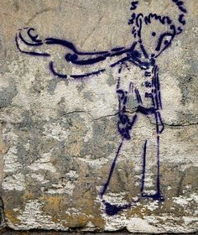
It all comes down to being a fellow human being
.
I totally agree with what you say, that those who work here they are often too careful, they meet people on their way home, who are out in the rain and don't have money for the bus but they can't even give them a lift because it’s their private car. We see the service user in a slightly different way than the professional employees do, at least where I work. It becomes closer, or it becomes more human

Slide 28
A dynamic bridge builder
I often feel that I am an interpreter. That I translate the language of the therapists to the street language of the service user. Then they understand it. And when the service user yells at them and uses bad language and swears and stuff f like that, I explain to the therapist that what happened now is that he was sad because you said this and that.
There is a great divide between us. That creates a high wall where one thing is good enough and the other is not. So we need to tear down that wall and use those experiences in a mixture.

Slide 29
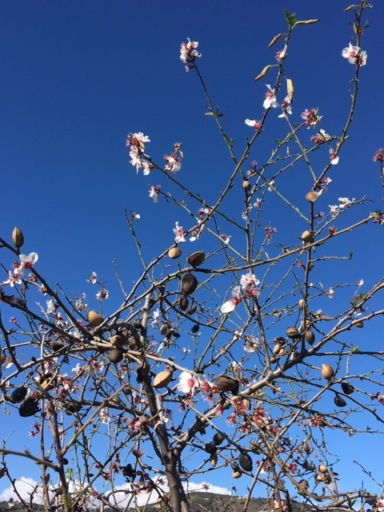
Real involvement
That the field starts agreeing with itself. How are we going to use this and where should they be and how can we use these resources as something more than just being this “carrier of hope”. What is this competence and how can we use it in the best possible way. That's important. One needs to think more at a system level.
We must be involved in the planning of services, just like that. For real. Not just like: «We had to include a peer worker».

Slide 30
Yet a long way to go
We have this free role. I think it ought to be like that, that we should say those things, if not, nothing will ever be said.
The others, you know, they have this therapeutic responsibility, they have to make plans, they have all these defined chores. Whereas I … «Now you are going to stay here and be a carrier of hope».

Slide 31
The educational program for PSW in Bergen, Norway
1 year program. Learning objectives related to: organization and services, utilizing ones lived experience-based knowledge, PSW role and skills, collaborating and partnering with others, systemic and social change, working within specific policies and practices, human rights and legislation, mental distress and recovery
3 modules: 20 weeks theory and 10 + 10 weeks of practice
Essay: combining own experiences, theoretical knowledge& practical work

Slide 32
Where are the new colleagues working?
In clubhouses & supported housing programs
In an educational program for professionals
As PSW in ACT/FACT teams
In a sport organization for serviceusers
As instructors in work programs
Most of the MB`s get a job on the place they had their practice – so they are already known when they are employed
Less «project» and safer working conditions (wages; permanent positions. rights)

Slide 33
Work situations
Almost all the MB`s work part time between 7 and 20 hours per week, after their own choice
Many have been living on pension for many years – and have now a mix of pension and salary
For some the main goal is “an ordinary job” or “an ordinary education”
For others the goal is this mix of pension and salary from the municipality
Today 10 has achieved ordinary employment in competition with professionals

Slide 34
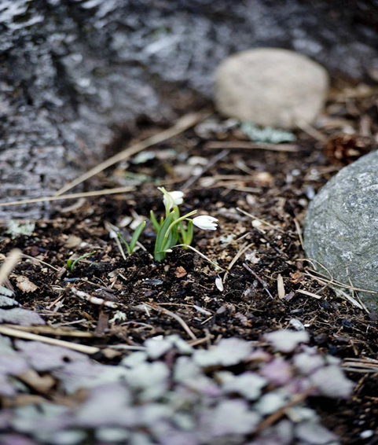
Training and supervision
Training for professionals – common training programs
Variety in length and scope
Common training on site
Training opportunities ( in what?)
Who should supervise? Peer mentors?
Organization: in services or in peer organizations?

Slide 35
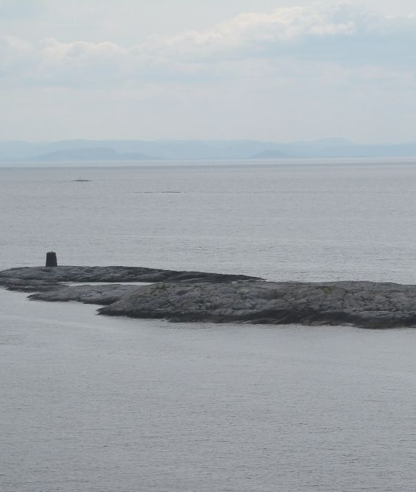
Reflections
Are experiences truly valued as knowledge?
Are services ready to embrace a processual form of knowledge?
Risk of polarization and isolation?
A divide between «us» and «them»? Between professional knowledge and experience based knowledge?

Slide 36
Lessons learned…
PSW represent important supplements, hope builders, respectful relationships, bridge to community & society
Helps in changing attitudes in services, create social communities and support participation
Freedom to more flexible support & help
Hope that professionals could be more open and share their lived experiences
Challenge: PSW could be too focused on their own experiences and solutions

